Slide 1
Αθήνα,
29 JULY 2020
“Creating wellness, producing value”

Slide 2
Disclaimer
This presentation has been prepared by Papoutsanis S.A. solely for informational purposes and cannot be used for any other purpose nor can it be addressed to any other person. The information included herein is confidential and cannot, therefore, be published, copied or dispatched.
This presentation is not an offer to buy or sell or a solicitation of an offer to buy or sell any security or instrument or to participate in any investment. No part of this presentation may be construed as constituting investment advice or a recommendation to enter into any transaction. No representation or warranty is given with respect to the accuracy or completeness of the information included in this presentation, and no claim is made that any future offer to transact on any relevant securities will conform to any terms that may be contained herein. Before entering into any transaction, investors should, therefore, determine any economic risks and benefits, as well as any legal, tax and accounting consequences of doing so, as well as their ability to assume such risks, without reliance on the information contained in this presentation.
PROJECTIONS – ESTIMATES – FORWARD LOOKING STATEMENTS
The presentation includes both information based on historical financial data as well as estimates, projections and other forward looking statements.
Any projections or other estimates in this presentation, including estimates on the performance of the company, our prospects, the result of our objectives and strategies, or the results of our operations and business, are forward looking statements based upon certain assumptions that in the future may be proven in fact wrong or inaccurate. These assumptions may be influenced by factors within or beyond our control, and actual results may materially differ from any estimates and projections included herein.
We do not intend to amend or update this presentation in case such estimates, projections or forward looking statements do not materialise or change in the future.
Notes:
Να το τσεκάρει η αλέκα

Slide 3
1
Extroversion:
Growing international presence. 2nd largest European soap producer.
Local Production:
Great production capacity, with ability to increase further, technological excellence and export activity
Sustainability:
Commitment to sustainable growth and conscious operation. Focusing on production of natural products using sustainable raw materials
Domestic market:
A historic brand with a leading position in B2C and B2B market segments
Partnerships:
Long-lasting co-operations with multinational leading players in all segments.
4 Business Segments:
Own brands, hotel amenities, contract manufacturing, specialty soap noodles. Less risk exposure.
Products:
A large portfolio of consumer and retail, exclusive, hotel and private label products

Slide 4
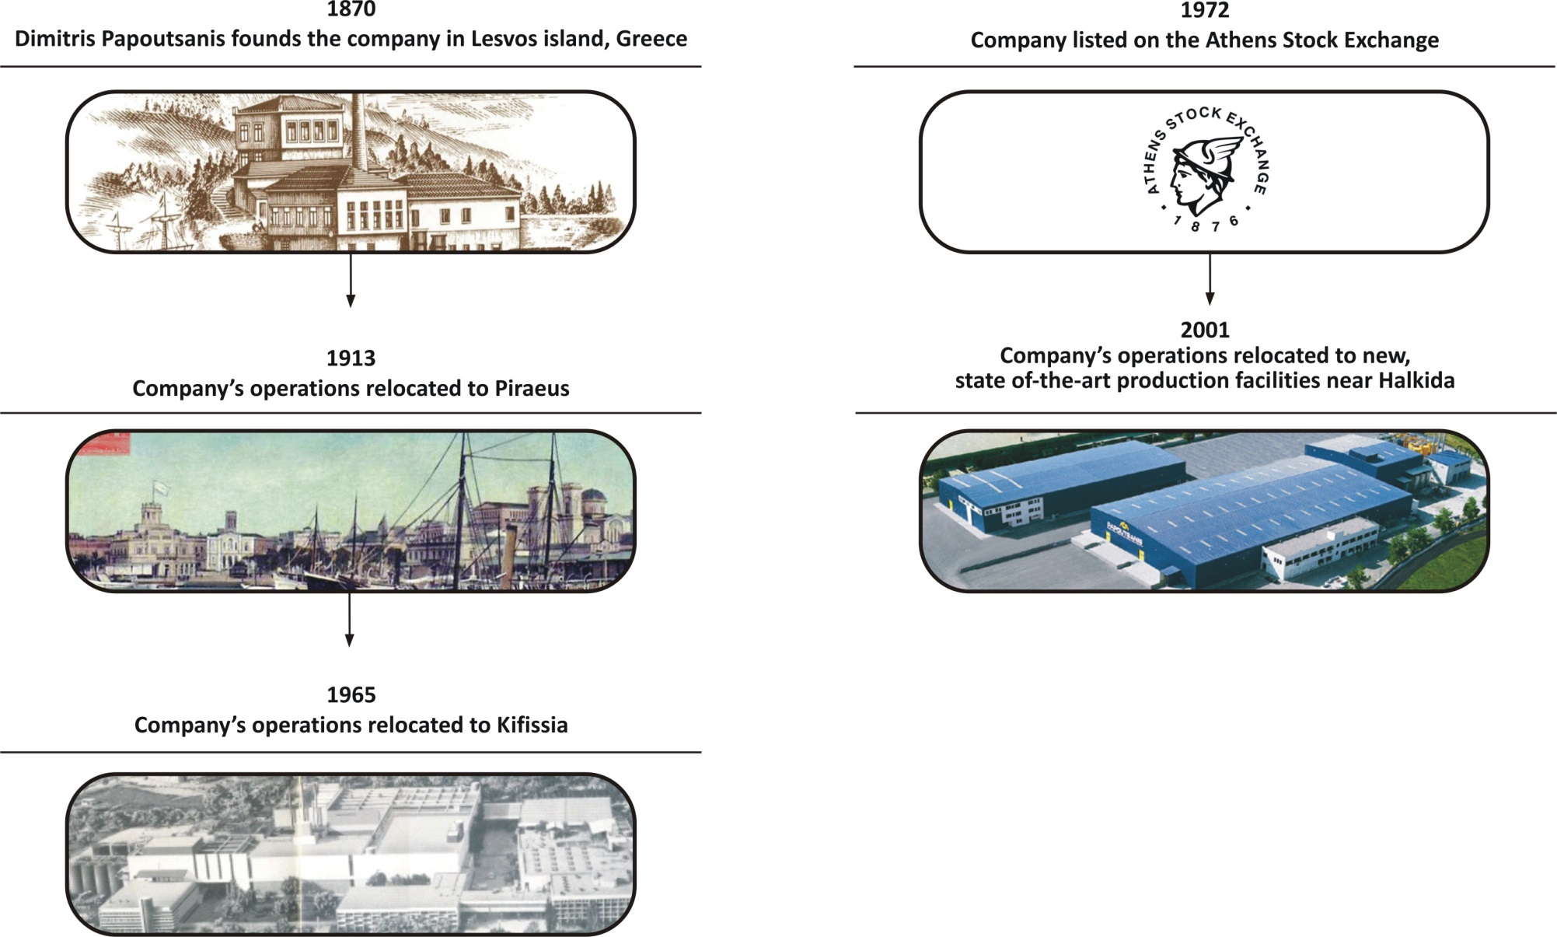
History

Slide 5
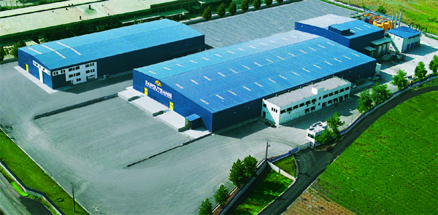
Capital Expenditure | Production Facilities
Extended over a 60,000m2 land in Halkida, just 70 km north of Athens
One of the largest and most modern soap manufacturing facilities in Europe
Over 100.000.000 units per year | 40% Spare capacity
Production Lines
Production of various bar soap types
Continuous and batch saponification units
Liquid Cosmetics production
Filling lines
PET, PE Bottles & PP Closing Cups Production
New plant investment: 50 mil Euros (2000-2019)
Capex in 2020 – 21: ca. 7 mil Euros (aiming to double retail bar soap capacity in order to address increased demand in Europe)

Slide 6
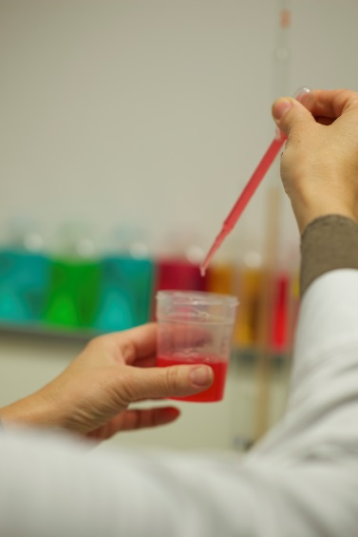
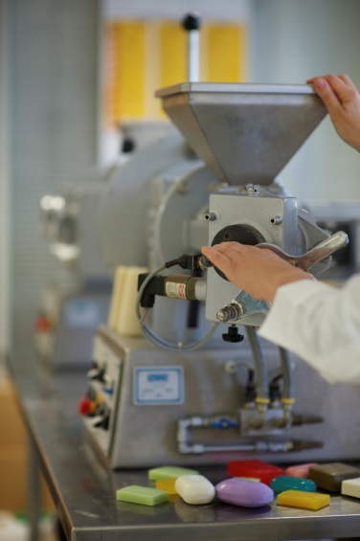
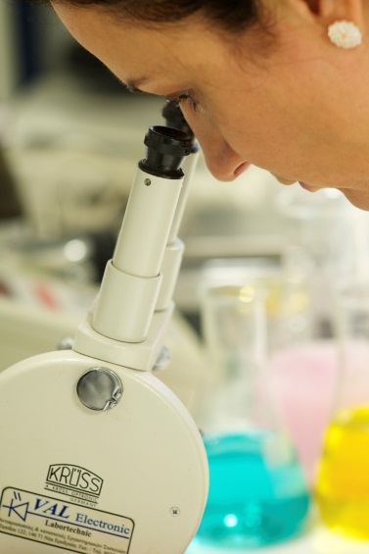
Strive for Quality & Innovation R&D and Quality Assurance
Fully equipped and manned in-house R&D laboratory
100-150 own innovative formulas/year
Excellent know-how in developing solid and liquid soap formulations
Meets high standards of multinational FMCG Companies and Retailers
Fully certified with respect to quality, sustainability and social responsibility:

Slide 7
ECO FRIENDLY
&
CLEAN FORMULA
Responsible Packaging
Natural Ingredients
100 % Recyclable
Packaging
RSPO Certified Soap Mass
SUSTAINABILITY
Biodegradable
Vegan Certification
Cruelty free
Post Consumer Recycled Bottles - Boosting Circular Economy
Cosmos Certified Formulas

Slide 8
Global Presence Exports in more than 25 countries
Countries:
UK, Germany, Italy, France, Spain, Portugal, Romania, Fyrom, Servia, Bulgarian, The Netherlands, New Zealand, Mexico, Lithuania, Slovakia, Albania, Belgium, Cyprus, Austria, Sweden, USA, Canada, Russia, Japan, Hong Kong, Australia etc.

Slide 9
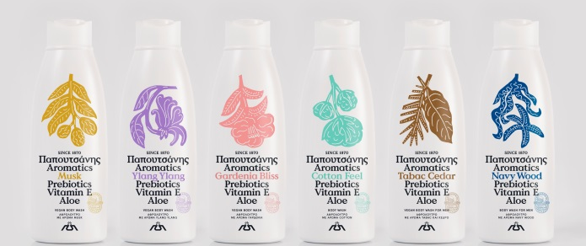
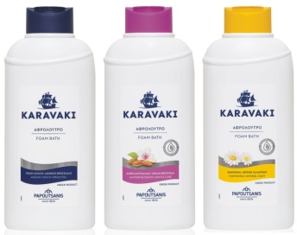
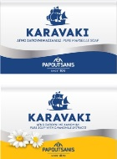
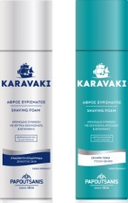
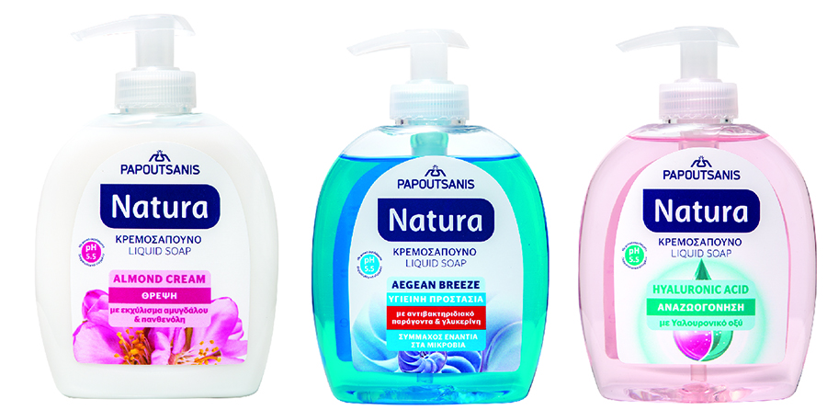
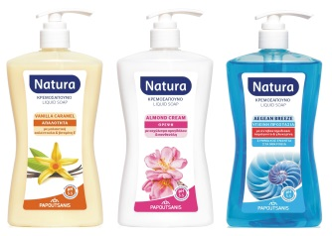
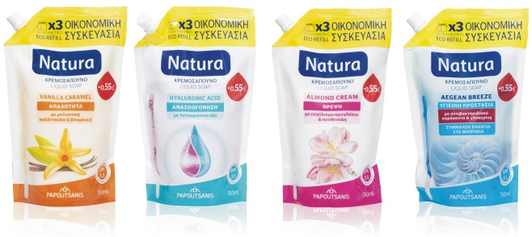
Own Brands - Retail
Strong Brand heritage with 150 years of presence in Greece
100% presence in organized trade
3.500 point of Sales
50.000 placements in Greece
Strong BTL activity
Innovative product launches every year and strong 3 year NPD pipeline
360^{ο} Marketing Support

Slide 10
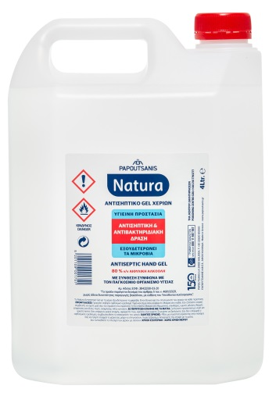
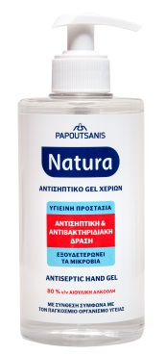
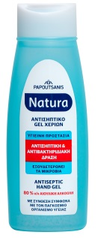
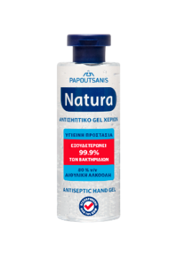
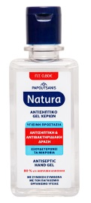
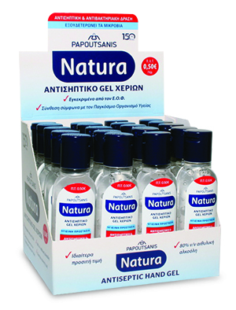
Own Brands - Retail
Hand Sanitizer

Slide 11
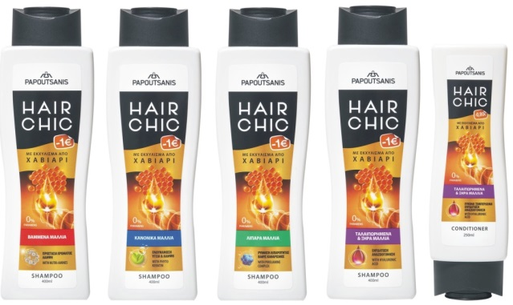
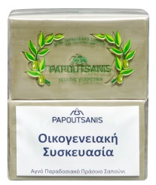
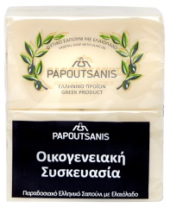
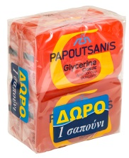
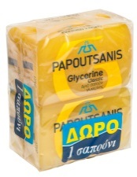
Own Brands - Retail

Slide 12
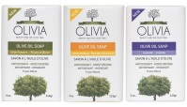
Own Brands – Selective Market & Pharmacies
OLIVIA - Beauty & The Olive Tree
When tradition meets modern technology ... the result bears the name Olivia:
A line of natural products for body and hair care blessed with beneficial properties of Organic Olive Oil & Organic Olive Extracts.
Olivia combines: 1. the deep knowledge of Papoutsanis on personal care products and olive tree beauty benefits with
2. the scientific R&D knowhow on olive extracts of the University of Athens (Dpt. of Pharmacognosy and Chemistry of Natural Products)

Slide 13
Key figures 2012 –2019 in ‘000 Euro
+27%
+17%
+15%

Slide 14
Key figures First Half 2017 – 2020 in ‘000 Euro

Slide 15
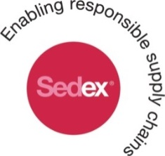
Corporate Social Responsibility
Commitment to communities and society as a whole through the long standing support to organizations, institutions and socially vulnerable groups.
Adopt Health & Safety measures for our employees and provide ongoing training on environmental management
Responsible business operation in order to minimize the environmental and energy footprint in the production facilities ( i.e. Use of natural gas, re-circulation of solid residues, use of up-to-date technology)
Transparency and open dialogue with stakeholders regarding environmental issues (i.e. Member of the Roundtable on Sustainable Palm Oil Association)
Notes:
PROS V&0 – ΤΙ ΘΑ ΜΠΟΡΟΥΣΑΜΕ ΝΑ ΠΡΟΣΘΕΣΟΥΜΕ?

Slide 16
Thank you!
PAPOUTSANIS SA
71st Km of National Road Athens – Lamias
34 100 Chalkida, Greece
T.: +30 22620 86430
email: info@papoutsanis.gr - www.papoutsanis.gr

